Slide 1
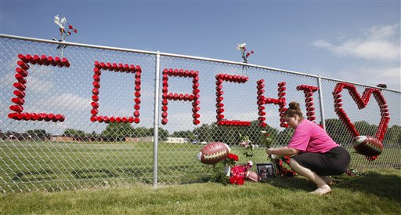
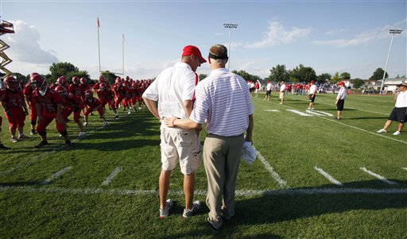
Sacred Acre
By: Mark Tabb
The story of Ed Thomas

Slide 2
Imagine your life being turned completely upside down!

Slide 3
A devastating tornado hit Parkersburg Iowa
http://www.youtube.com/watch?v=xmnRgg-YHII

Slide 4
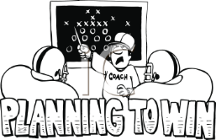
Would you step up and be a leader like Ed Thomas?
Or would you just fade into the backround?

Slide 5
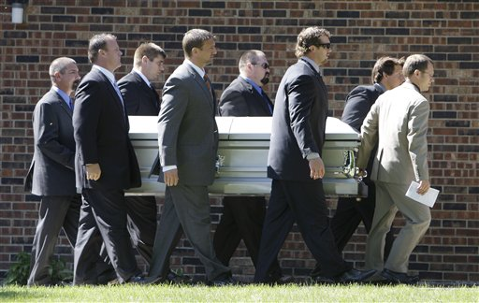
Ed Thomas
Ed Thomas was a lot of things to many people
An amazing football coach
A great leader.
A person who lived a very Christian life.
While helping mold young people into great men.
But on June 24, 2009, Ed was shot by one of his former players

Slide 6
Sources
httphttp://schools.iclipart.com/index.php
s://www.apimages.com/uns/logipfailed.aspx

